Slide 1
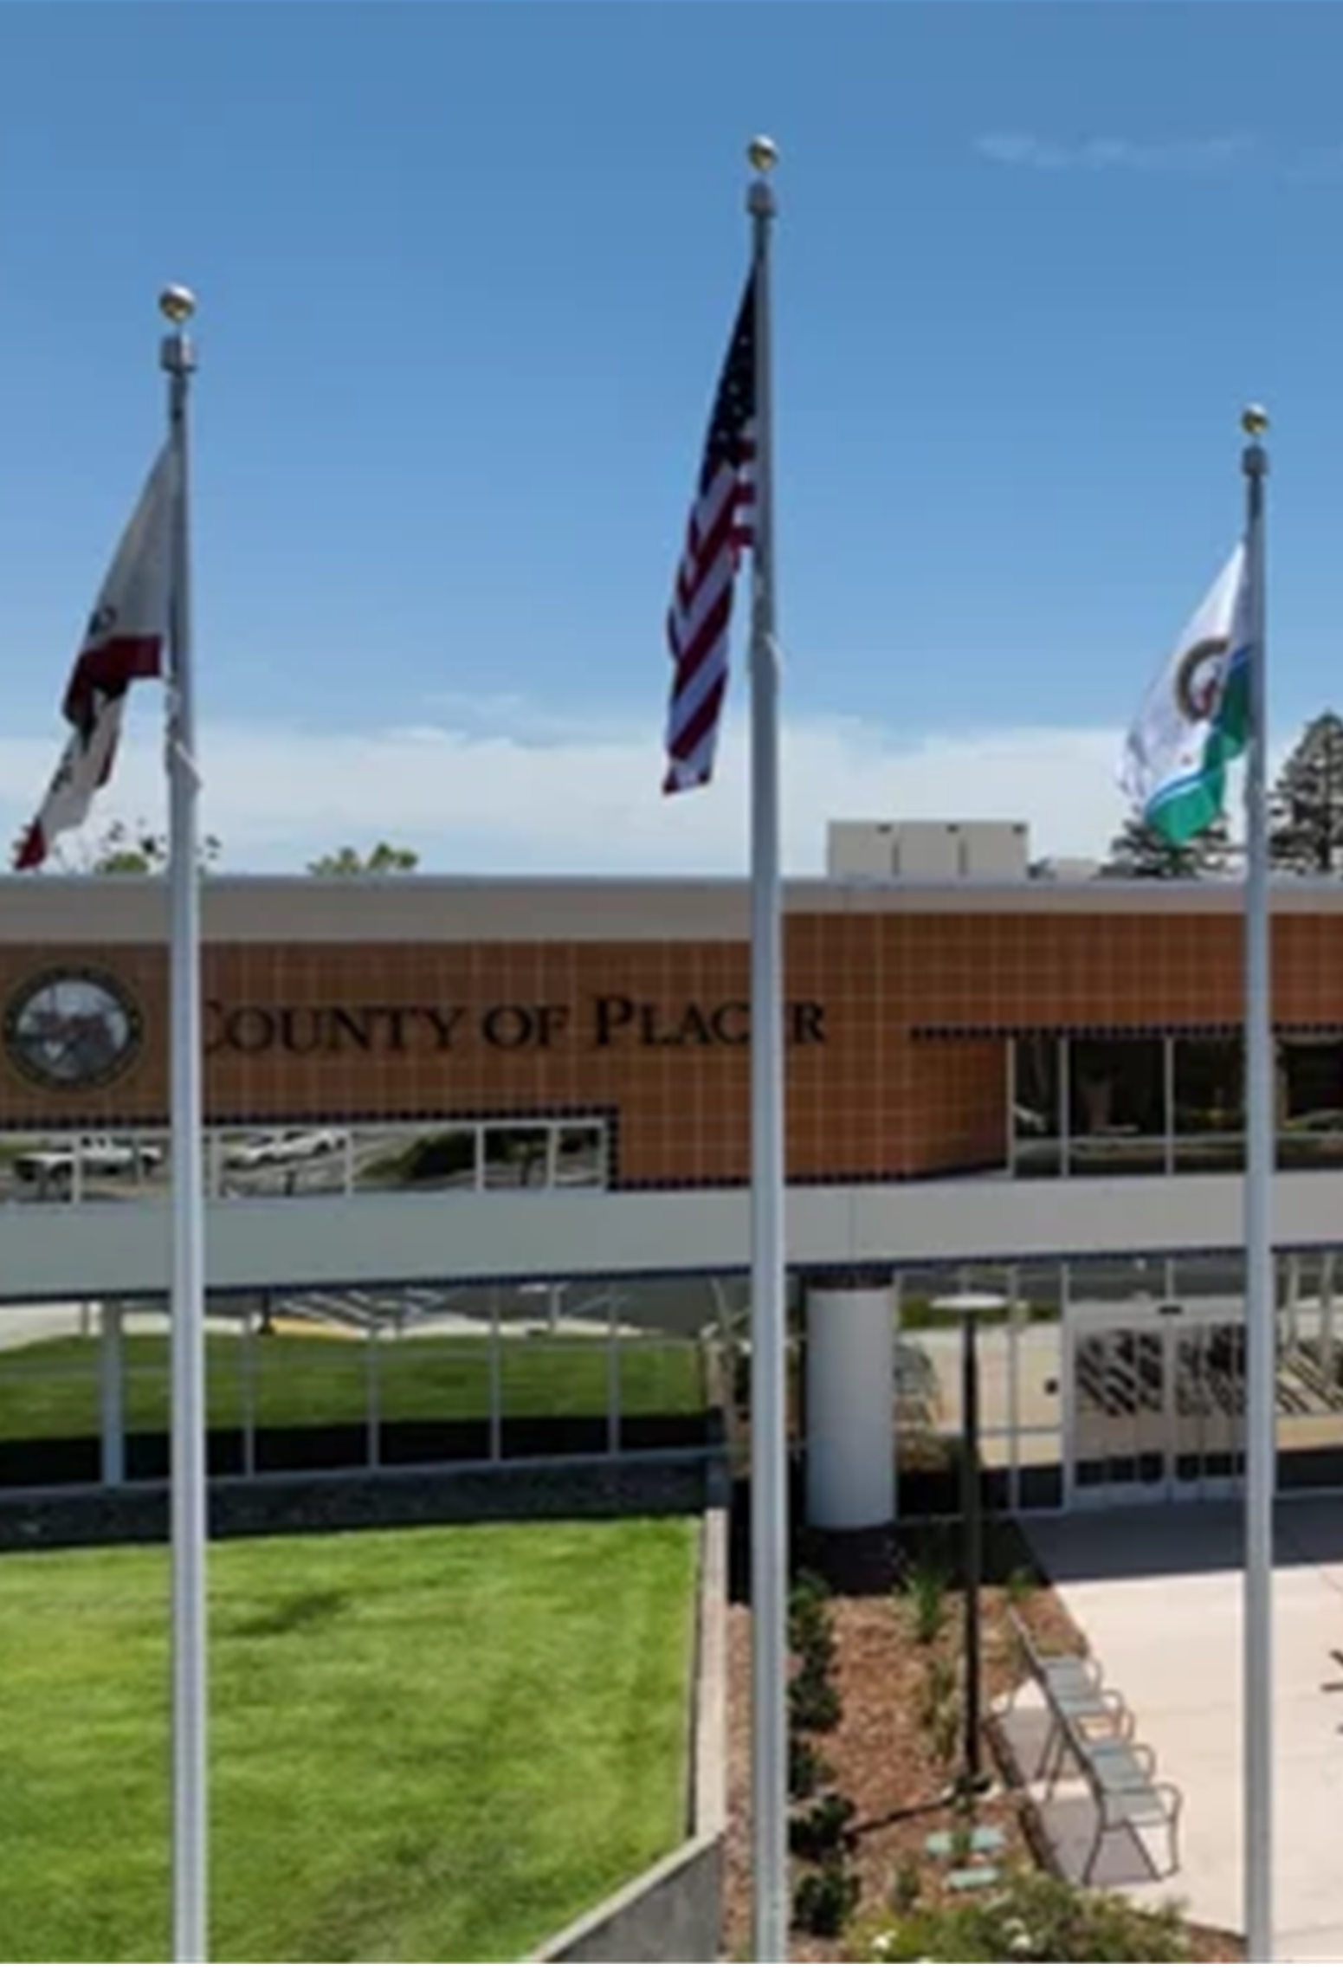
Voting Accessibility Advisory Committee (VAAC)
A forum for representatives of the disability and senior communities to have open discussions about any challenges they face
while voting.

Slide 2
Language Accessibility Advisory Committee (LAAC)
A forum where representatives of voters with diverse language needs have the opportunity to discuss and provide input on language accessibility issues.

Slide 3
Agenda
Elections Staff/Attendee Introductions
November 5, 2024 General Election Report
Questions & Answers
Future Agenda Items

Slide 4
Placer County Registration Statistics
35 days prior to
November 5, 2024
General Election
288,076 total registered voters
117,649 40.8% Republicans
91,008 31.6% Democrats
54,994 19.1% No Party Preference
8.5% of voters registered as “other”
Notes:
As of the 15-day close of registration prior to the March Primary Election:
281,556 registered voters in Placer County
41% Republicans 114,289
32% Democrats 89,229
19% No Party Preference 54,255
8% belong to other “qualified” political parties (Green, American Independent, Libertarian, Peace and Freedom)
miscellaneous parties attempting to qualify (Reform Party, Communist Party, etc.)

Slide 5
County Comparison
By Election Day, Placer County:
Grew by 7,000 voters to 295,072
Overtook Stanislaus County as the 17th largest county in voter registration
Had over 95% of eligible voters registered, the 2nd highest percentage in California (only Alpine County beats us at 96%).
Is in the top 5% of largest counties in the nation
The number of Placer County voters increased by 14,000 since March primary, the entire voter population of 9 CA counties in 8 months
Notes:
Out of 58 counties, Placer County is now the 17th largest county in voter registration in California.
We are also very close to the top 5% of largest counties in the nation.
We now have the 3rd highest percentage of eligible voters who are registered in California.
Over 93% of our eligible voters are registered.

Slide 6
2024 General Election Voter Turnout
238,700 ballots cast
83.2% of eligible Placer County voters
Average Placer turnout (presidential general elections): 80% to 84%
Placer County higher than California average (71.5%) by 12 percentage points
Placer turnout was 8th overall
In counties our size or larger, only Sonoma County had a higher turnout at 84.7%
Over 3,700 people requested same-day voter registration ON Election Day
Notes:
This election was historically lower in turnout at a little over 48.3%. Usually in Placer we see a 55% to 60% in a presidential primary election.
Even though turnout was light, we still have higher turnout than most other counties in California.
The state turnout was 35%, so we are beating the state by almost 13 percentage points.
Out of California’s 58 counties, our turnout is currently 16th highest.
Of counties our size or larger, only Sonoma County has a higher turnout at 50.2%.
We attribute our lower-than-average turnout to the fact that the presidential contests were essentially non-contested by the time Super Tuesday rolled around.

Slide 7
2024 General Election Voter Turnout Cont’d
52,500 voters cast their ballots in person during the 11-day voting period
183,000 voters cast vote-by-mail ballots
87,000 ballots were collected from drop boxes
76,000 ballots were returned by mail
17,500 were dropped at a vote center
2,500 were dropped at the Elections Office
278 non-UOCAVA ballots issued via RAVBM; 104 returned
1224 registered, active UOCAVA voters by end of Election Day
790 UOCAVA ballots counted; 464 issued via RAVBM
739 provisional ballots cast; 45% qualified to be counted
4072 CVR ballots cast; 97% qualified to be counted
Notes:
Our turnout was 48.3%, with almost 135,869 ballots cast:
15,295 vote center ballots (including provisions)
120,574 vote-by-mail ballots
8 voters that used RAVBM.
86 UOCAVA voters used RAVBM.
104 provisional ballots were cast; more than 85% of them were qualified to be counted.
446 CVR ballots were cast; more than 97% were qualified to be counted.
For this presidential election the Democratic, American Independent, and Libertarian parties were allowing crossover voting;
2,845 Democratic/NPP requested ballots
707 American Independent/NPP requested ballots
133 Libertarian/NPP requested ballots

Slide 8
Election Report In-person Voting
Of the 52,500 voters who cast their ballots in person:
27,800 voted during 10-day early voting period
24,700 voted on Election Day
19,500 voters cast traditional polling place ballots
Over 33,000 scanned their vote-by-mail ballots using “Sign, Scan & GO!”
Notes:
4,000 voters voted early in the first 10 days before Election Day and around 11,000 waited until Election Day to vote
6,300 voters cast their ballots as traditional polling place ballots
Over 8,000 scanned their vote-by-mail ballots at the vote center and watched their ballots being counted right there in real time. Part of this was because we asked our vote center staff to encourage voters to scan their ballots in this manner

Slide 9
Vote Center Utilization
Most popular vote center overall:
Rocklin Clerk-Recorder-Elections Office
5,649 voters over 11 days
Second Place
Martha Riley Library (Roseville)
5,271 voters over 11 days
Busiest vote center on Election Day:
Rocklin Clerk-Recorder-Elections Office
1574 ballots cast
Second Place
Lincoln Library
1,316 ballots cast
In-person voting increased from 11% (March primary) to 22%, but nearly 8 out of 10 votes cast were by VBM ballot:
By mail
By drop box
At a vote center
Notes:
Our most popular vote center was at our new Rocklin office with 1,247 voters over 11 days
The busiest vote center on Election Day was the Granite Bay Library location with 718 voters casting ballots at this location
By encouraging voters to scan and count vote-by-mail ballots at the vote centers, we increased our in-person voting participation from 8% to around 11%. While there was an increase in our in-person voting, that means that roughly 9 out of 10 voters were not in person and either mailed their ballot back, placed their ballot in one of the 30 ballot drop boxes or took their ballot to a vote center and dropped it off in that chosen location

Slide 10
Drop Box Utilization
31 Placer County Drop Boxes
Highest number of returned ballots:
13,274 - Placer County Clerk-Recorder Office – Auburn
Lowest number of returned ballots:
235 - Olympic Valley Public Utility District
Ballots returned to drop boxes specifically requested by VAAC and LAAC:
390 - Gurdwara Sahib Sikh Temple
1461 - Oriental Market
Ballots returned to drop boxes specifically requested by Placer residents:
445 Tahoe Truckee Airport
Notes:
Placer County had 30 drop boxes located throughout the county.
Highest number of returned ballots:
9,494 Placer County Clerk-Recorder Office – Auburn
Lowest number of returned ballots:
133 Olympic Valley Public Utility District
Requested boxes specifically from LAAC and/or VAAC meetings:
347 Gurdwara Sahib Sikh Temple
825 Oriental Market
At the request of Truckee residents to add a drop box, we are working with the Tahoe Truckee Airport District to add a 24/7 drop box. The drop box should be operational by the November general election.

Slide 11
Canvass Period & Manual Tally
Postelection functions performed:
Reconciling voter rosters
1% manual tally
Placer hand-counted 12,584 ballots:
10,384 vote center ballots
2,200 vote-by-mail ballots
8,777 challenged for non-matching or missing signatures
Outreach to voters conducted by:
Phone
Email
Letters (2)
7,994 (91%) were cured and qualified
Notes:
We carried 69,436 ballots into the canvass period.
There were 2,708 ballots that were challenged for non-matching or missing signatures. After the office reached out to voters by mail, phone, and email to cure them 2,441 were cured and qualified, accounting for a 90% cure rate.
We perform two very important postelection functions during the canvass period:
We reconcile our voter rosters, which checks to make sure our volunteers didn’t stuff the ballot box at the vote centers.
And we performed a manual tally – auditing our machine count to make sure our IT staff programmed the machines correctly and nobody corrupted the machines out at the vote centers.
6,062 vote center
1,401 vote-by-mail

Slide 12
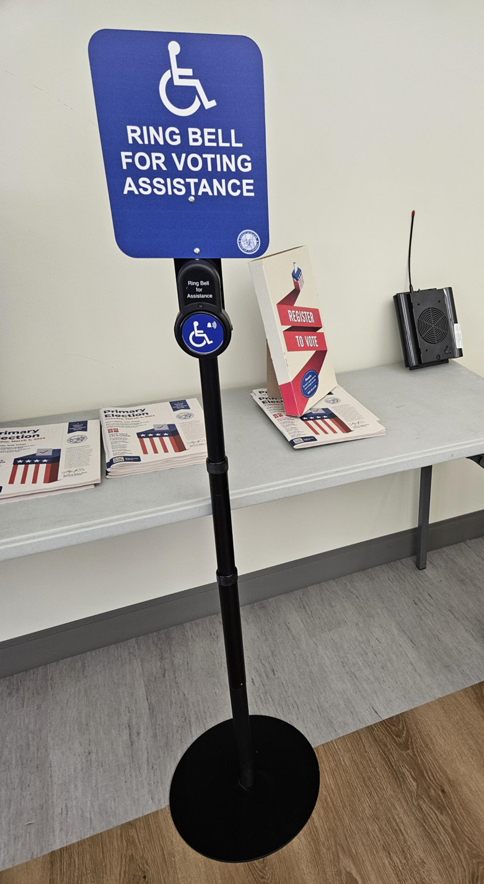
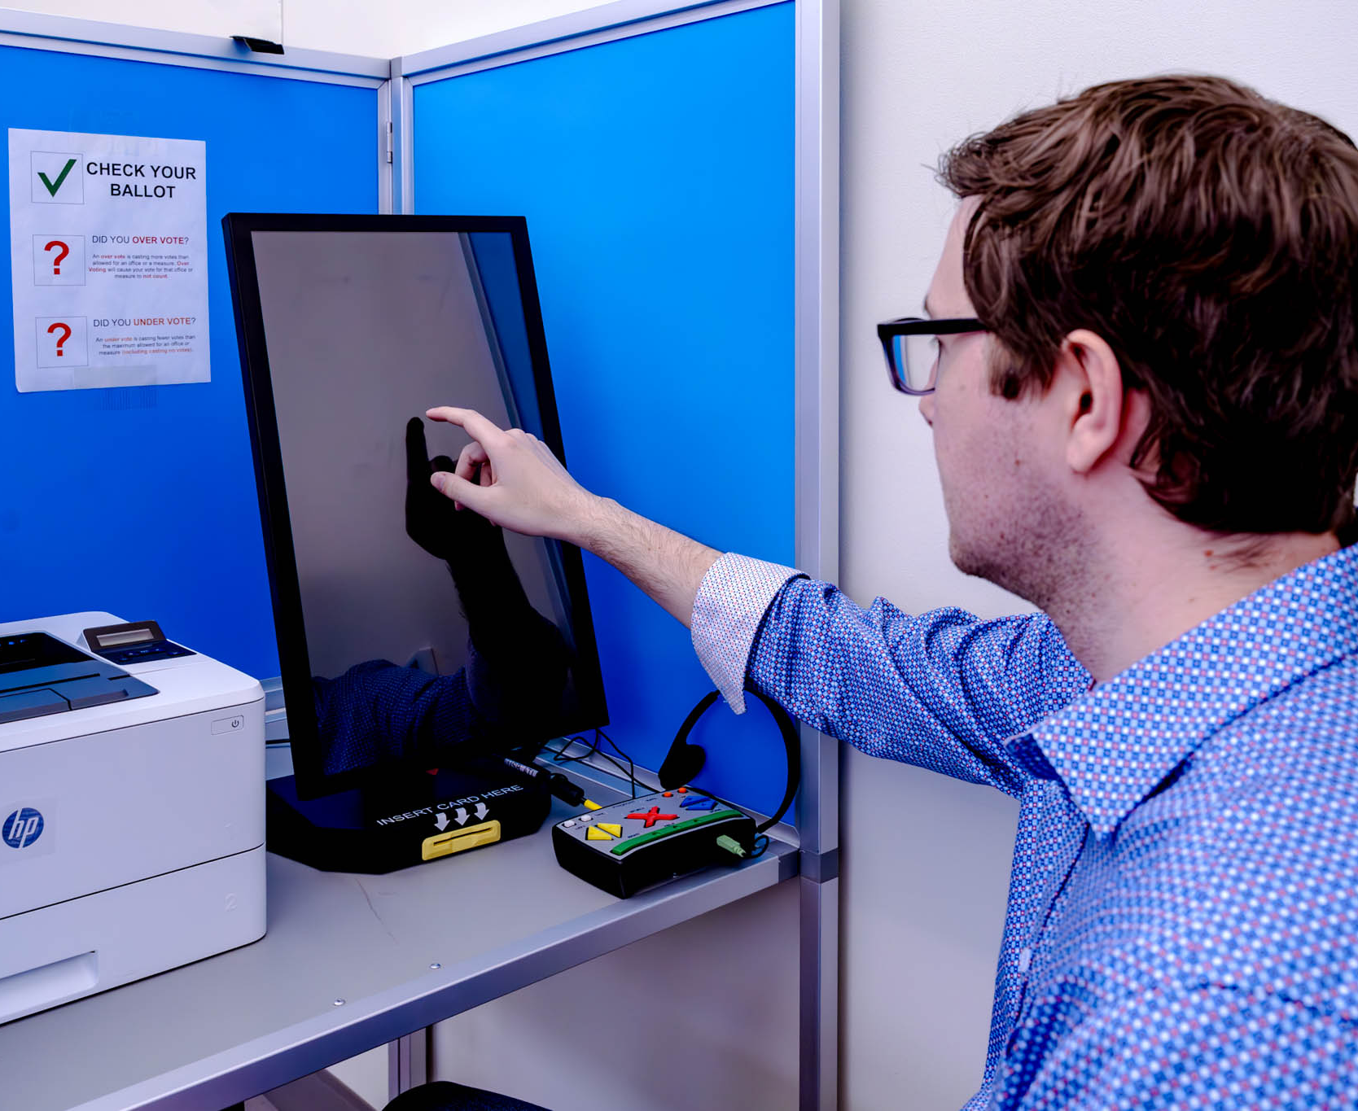
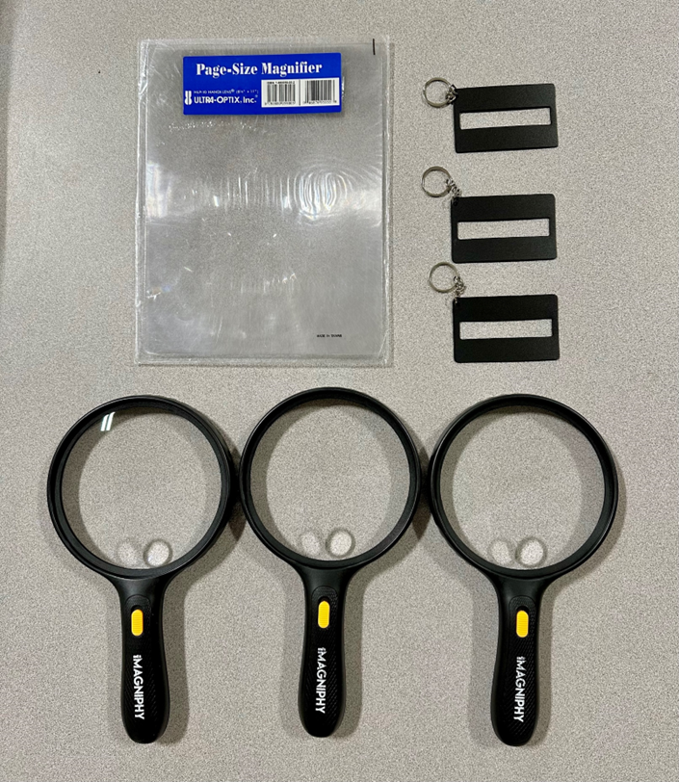
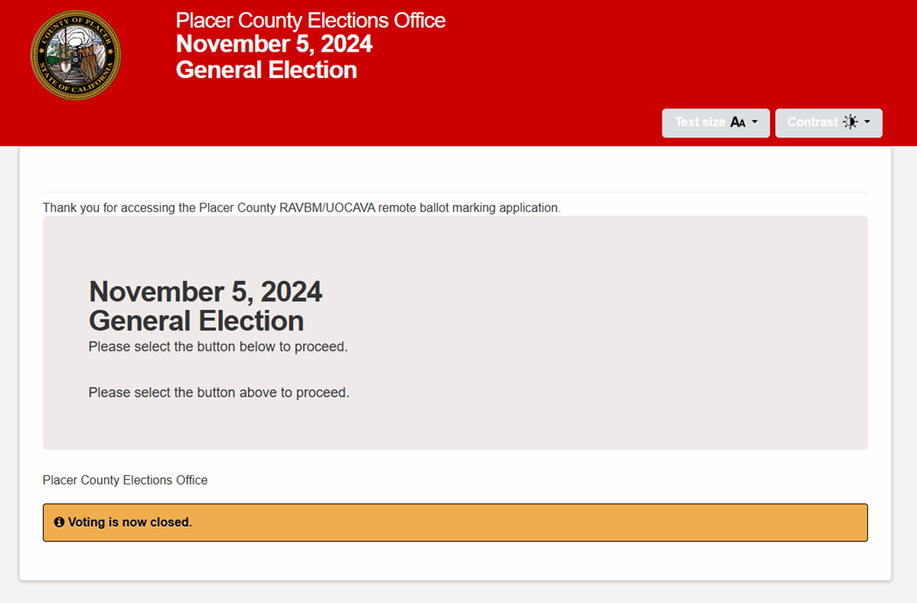
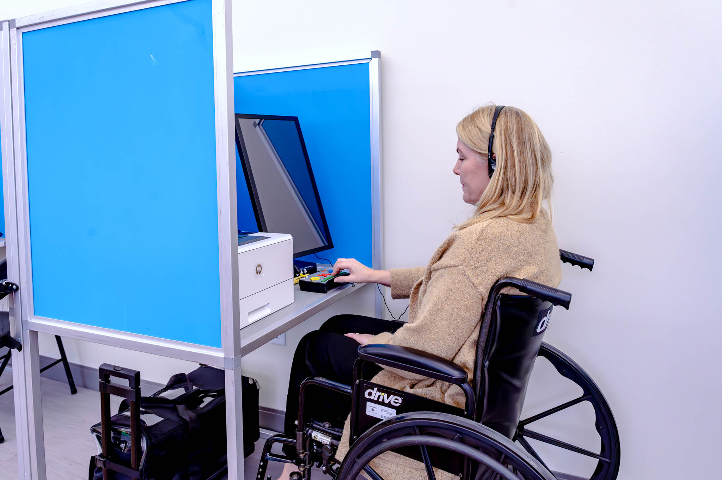
Accessible Voting Tools and Resources

Slide 13
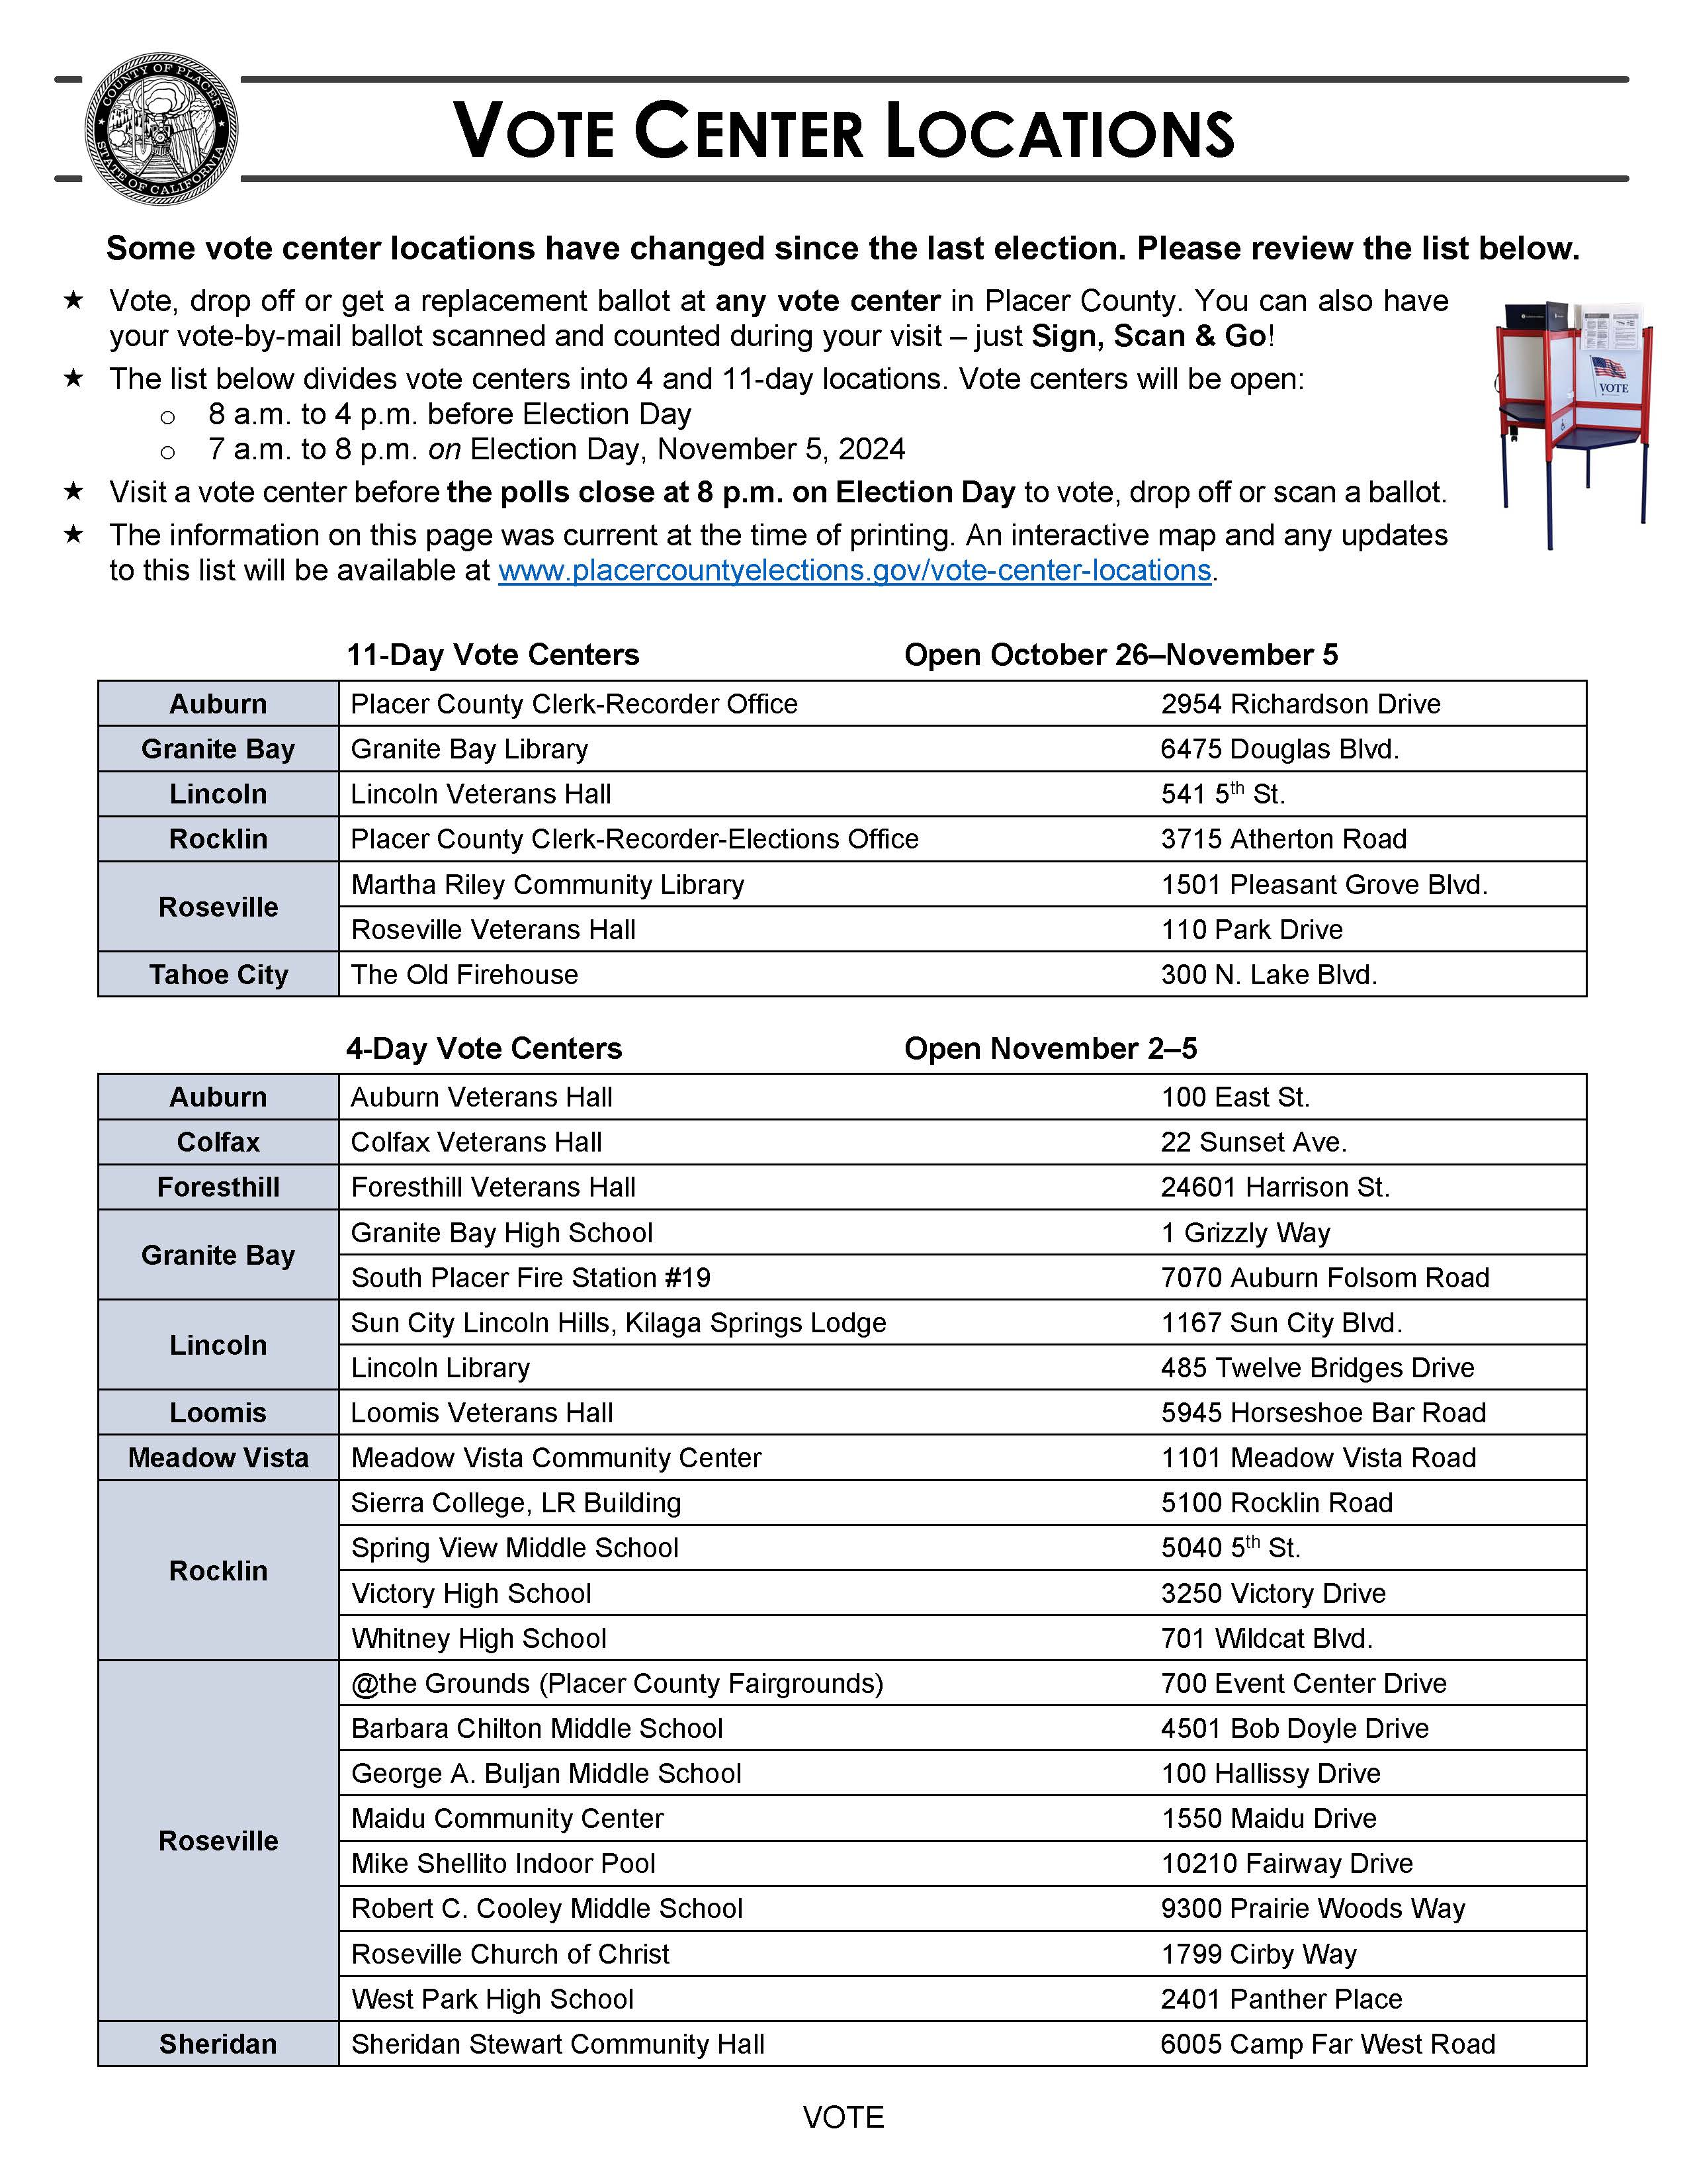
Vote Centers

Slide 14
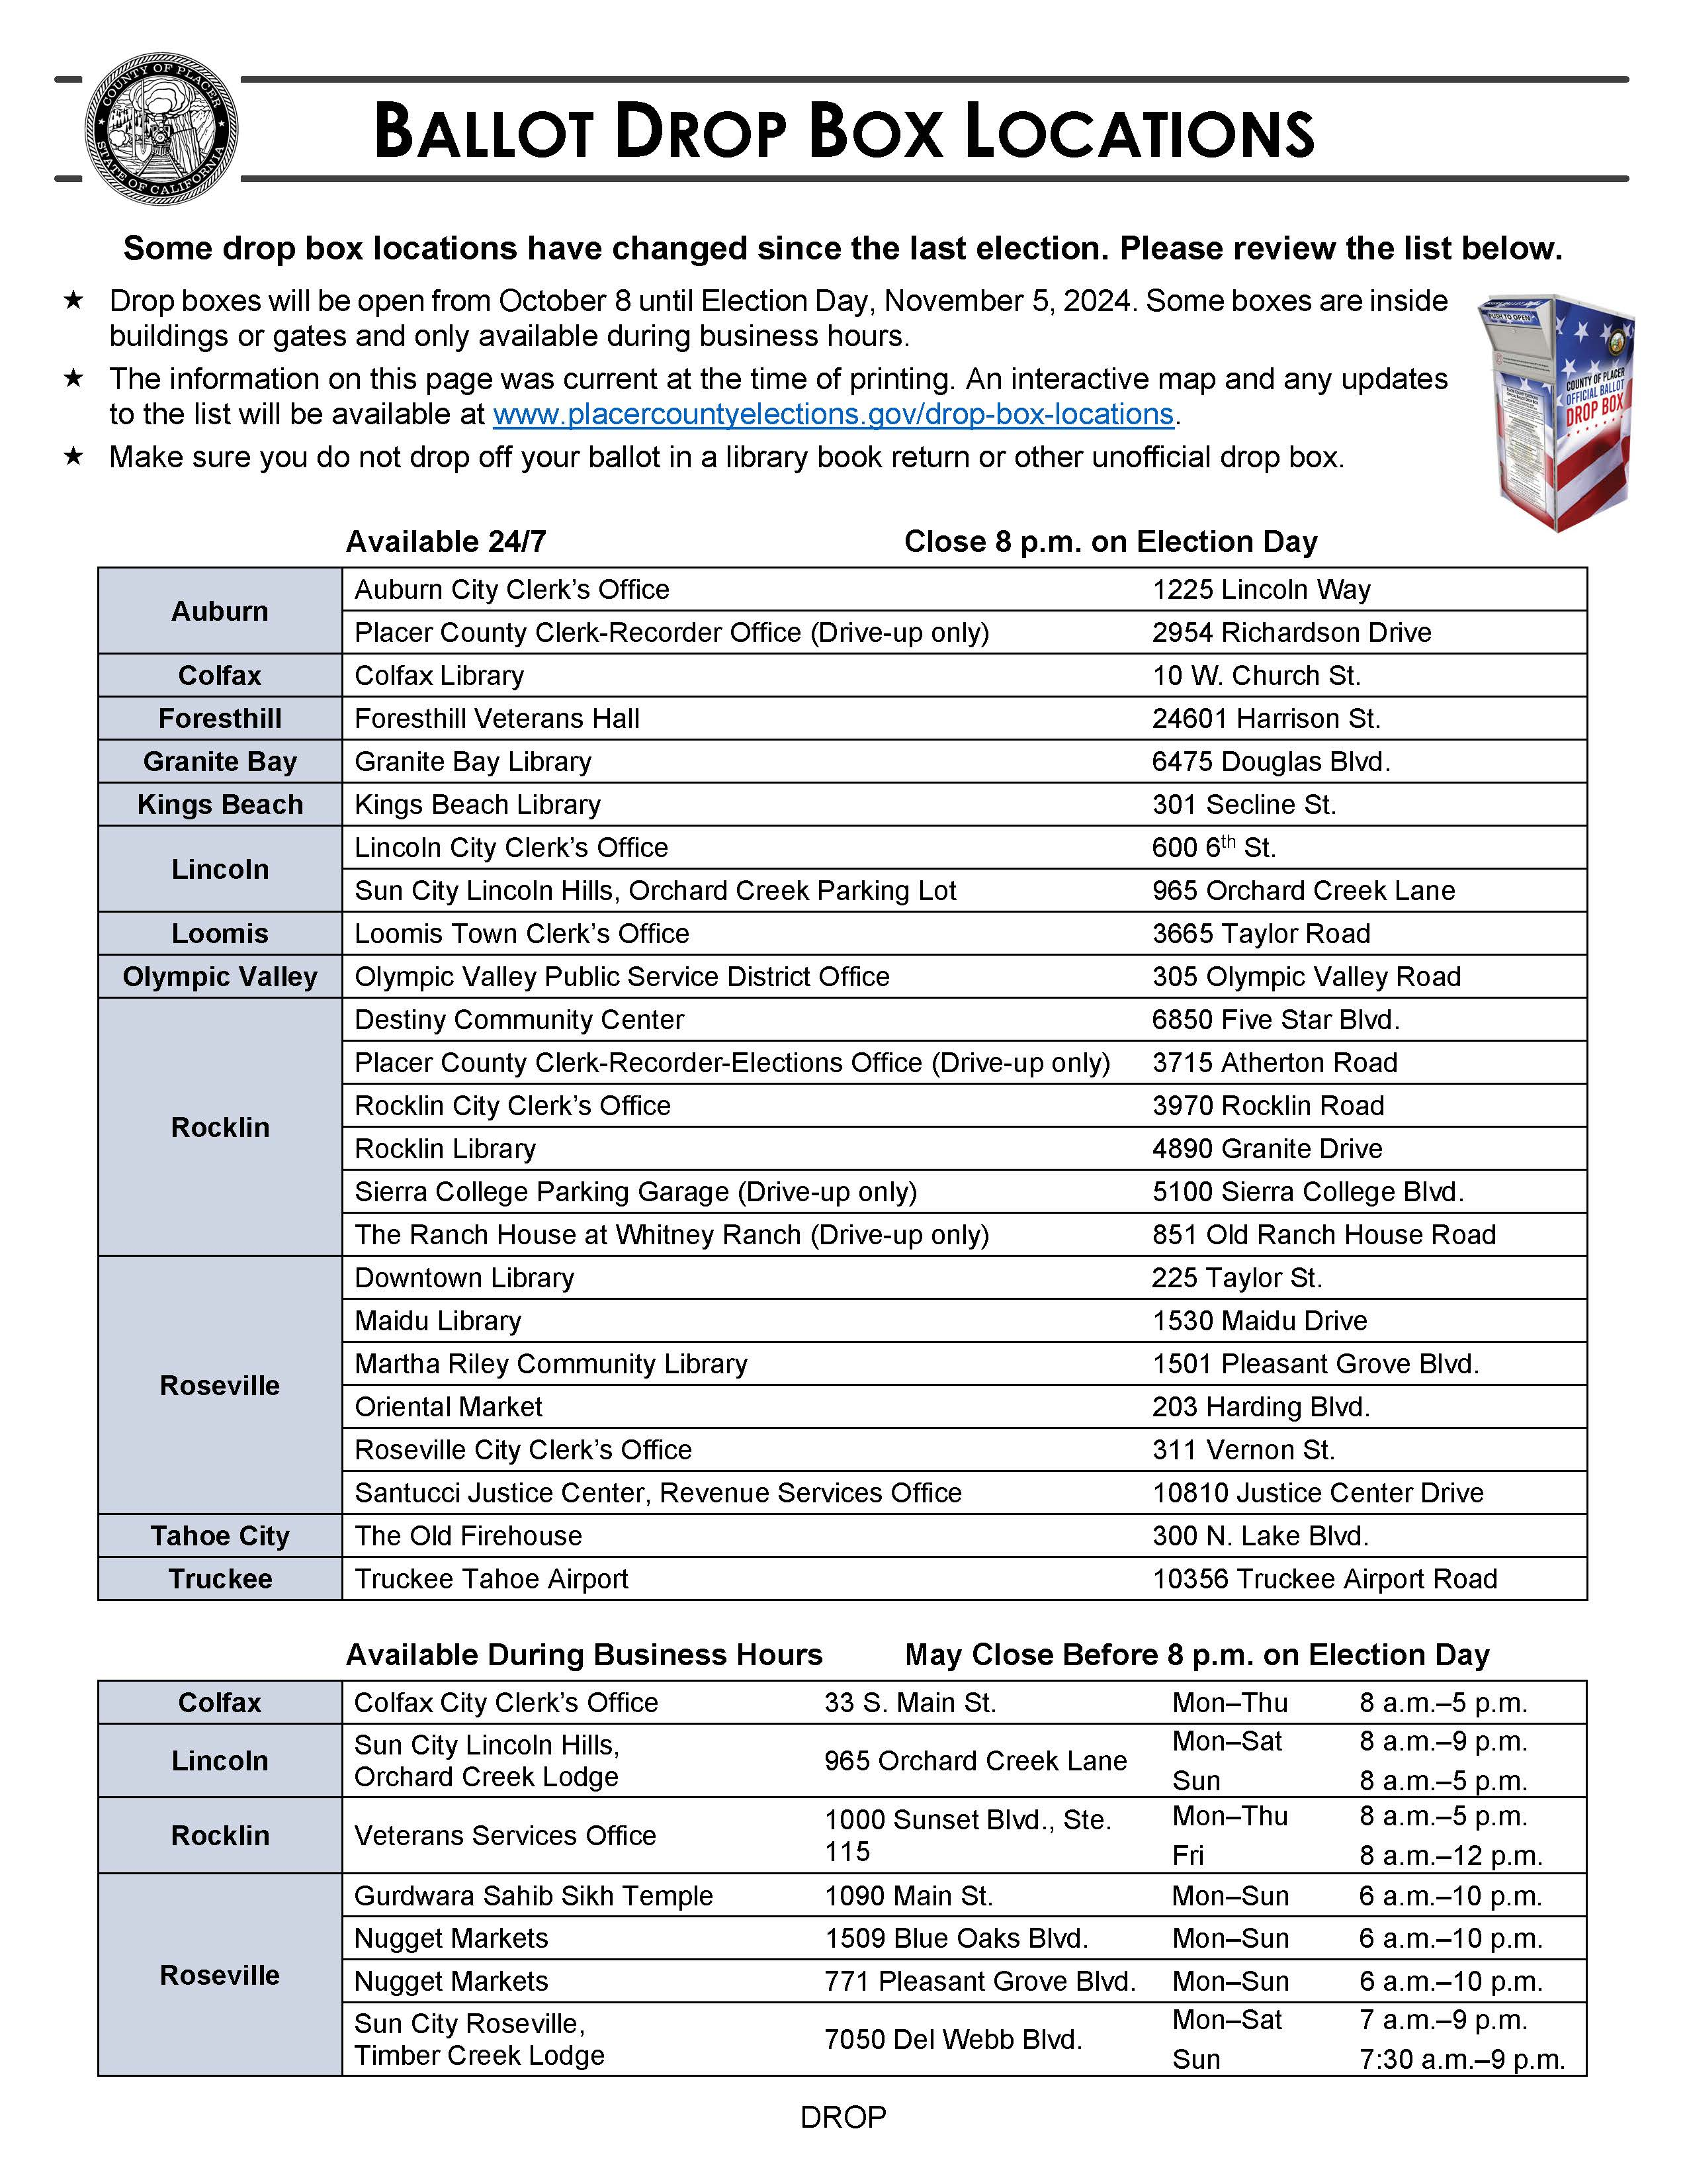
Drop Boxes

Slide 15
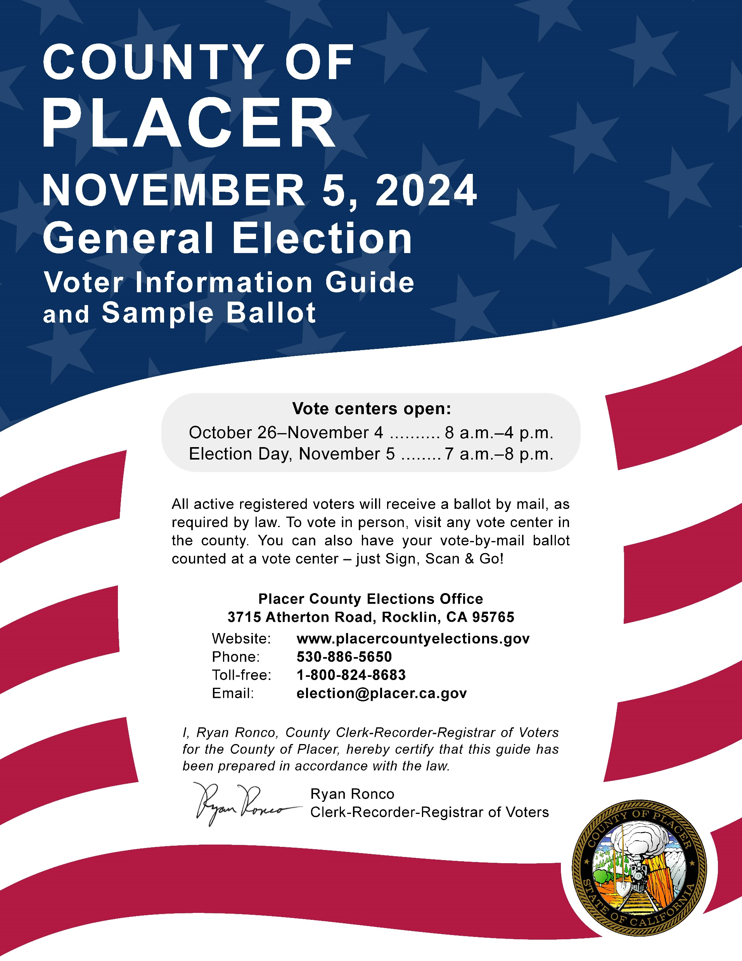
Voter Information Guide

Slide 16
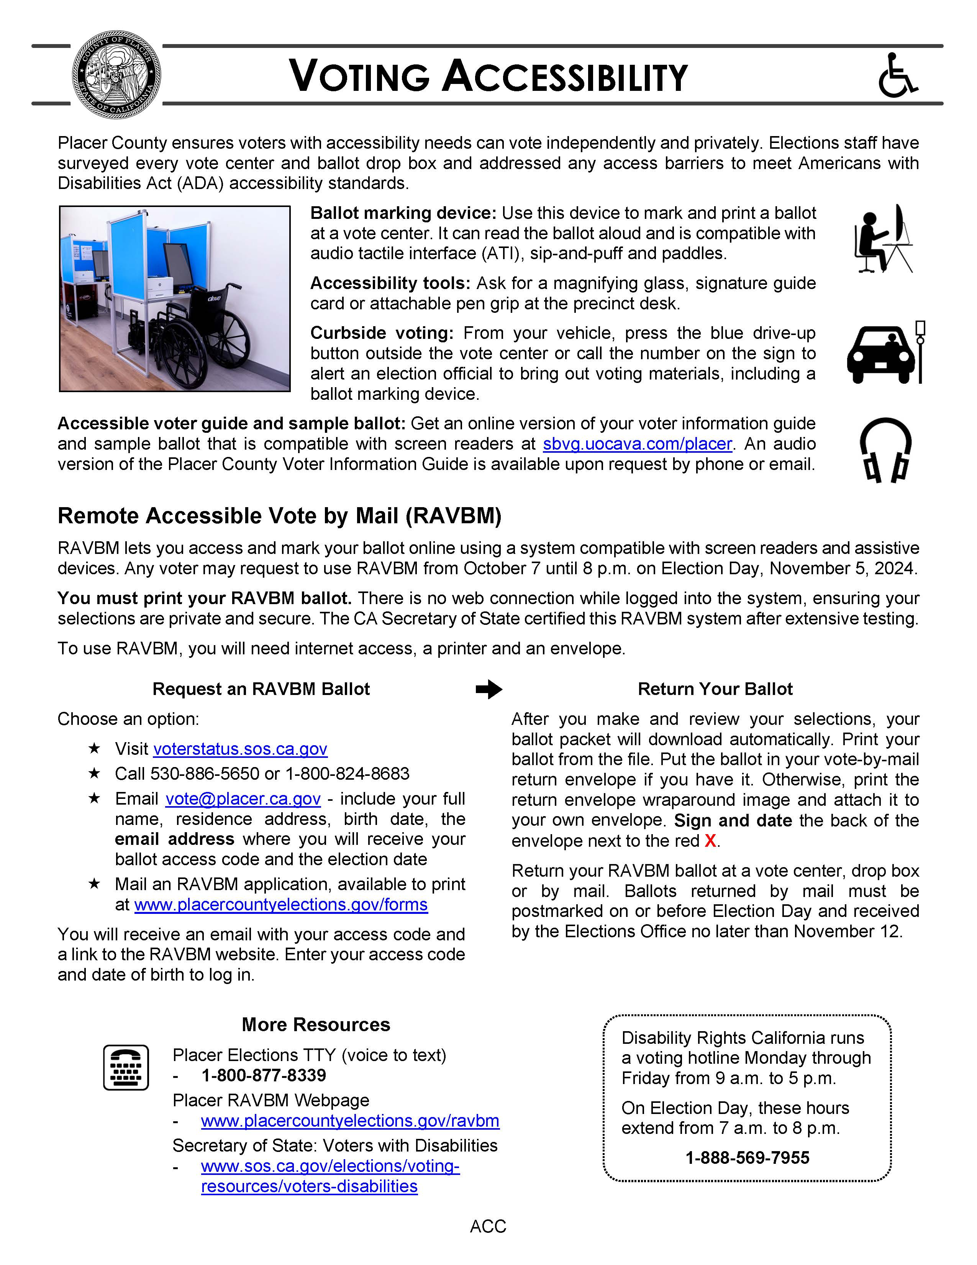
Voter Information Guide Accessibility RAVBM Page

Slide 17
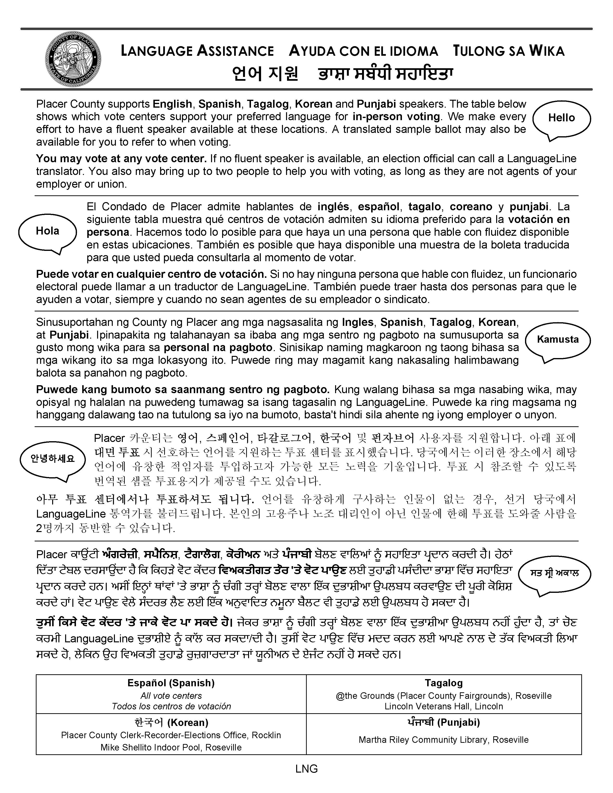
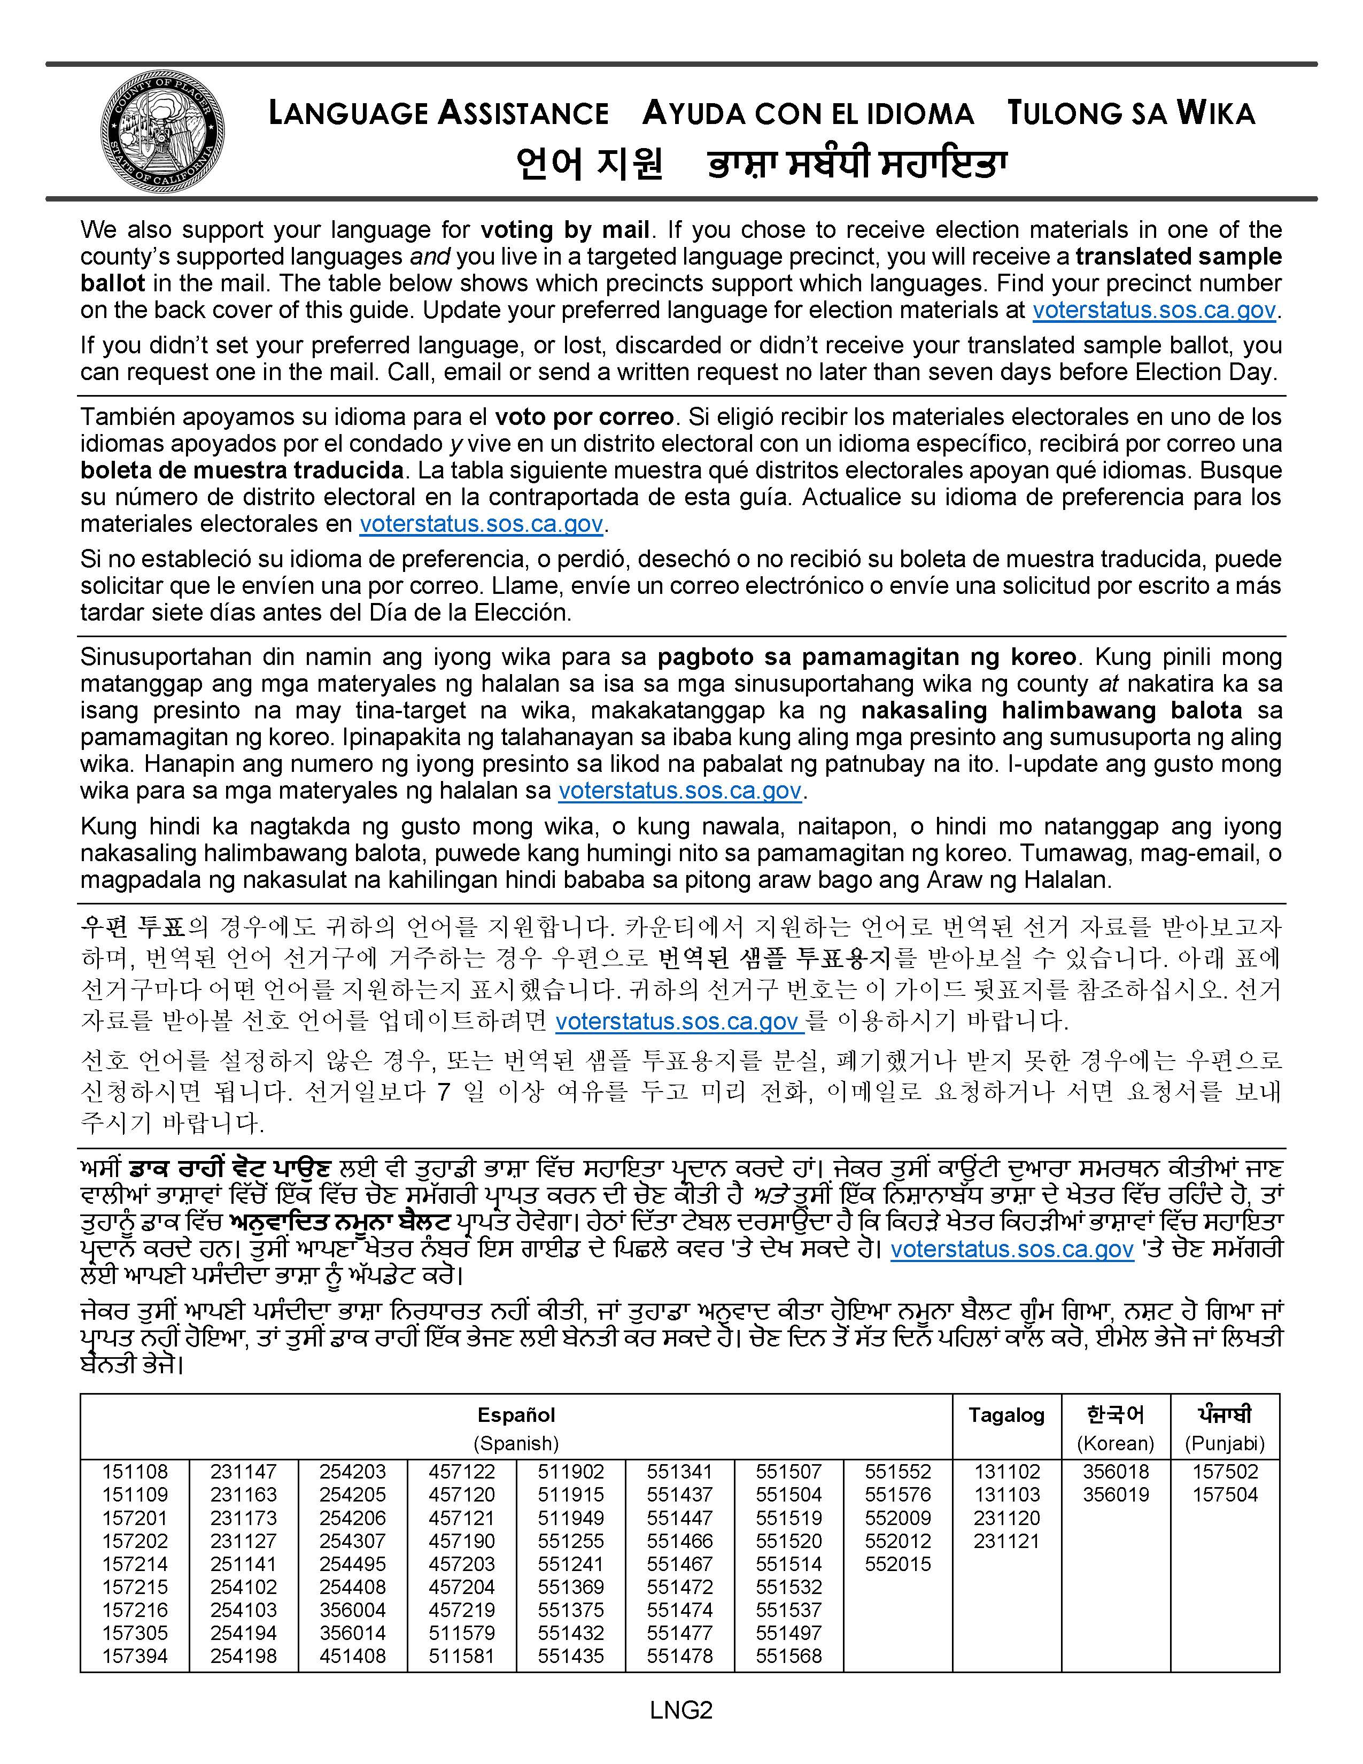
Voter Information Guide Language Accessibility

Slide 18
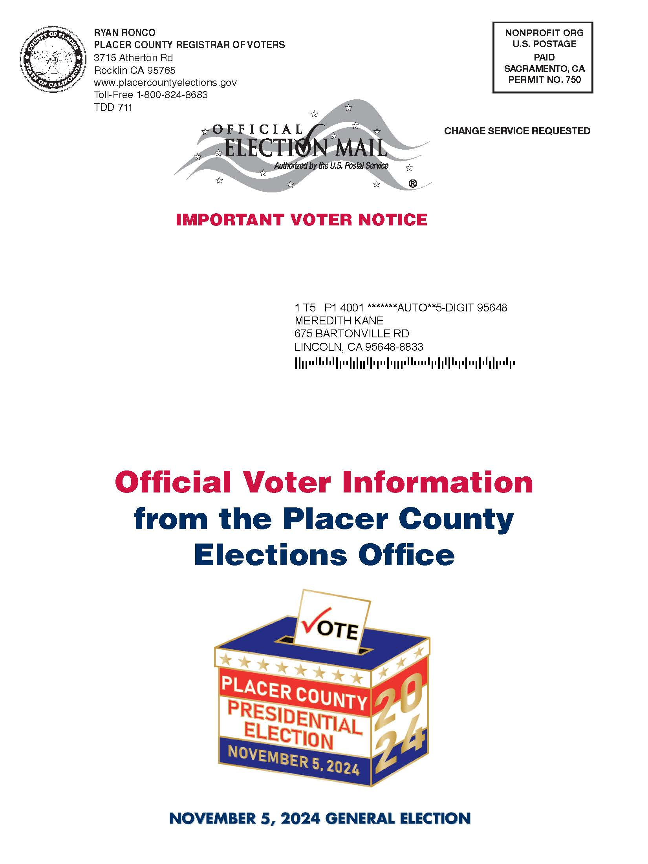
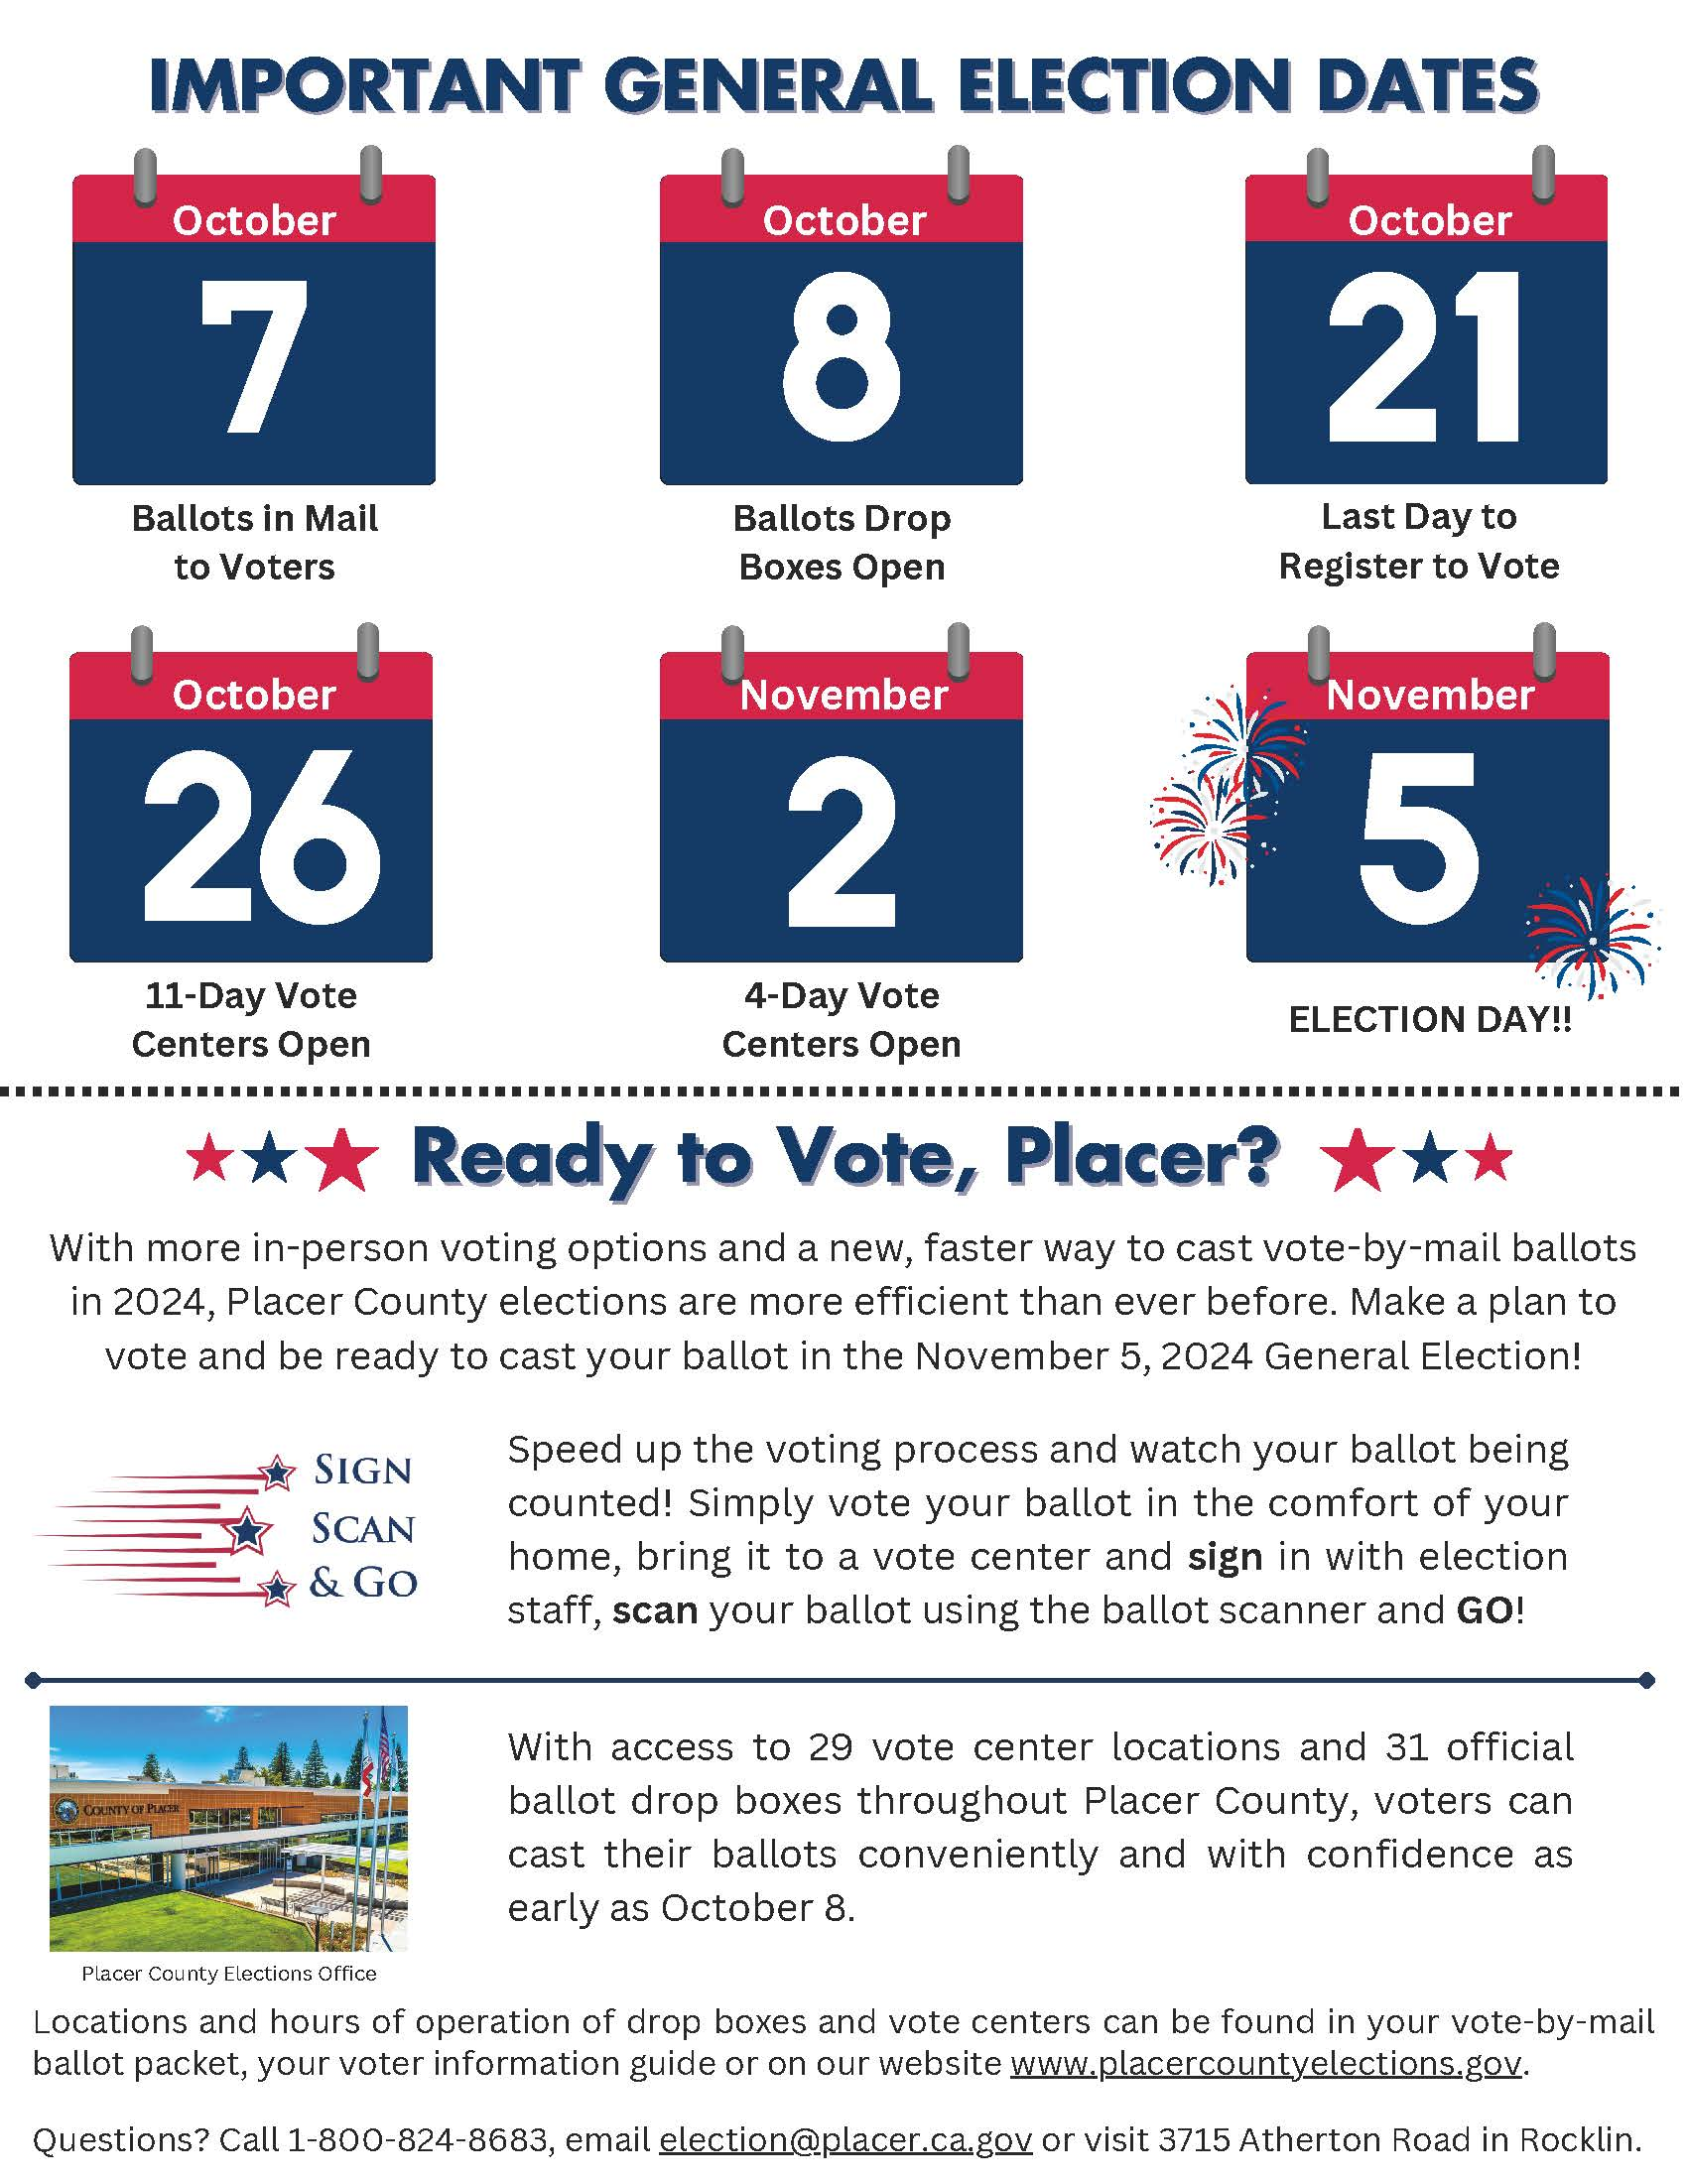
VCA Postcard #1

Slide 19
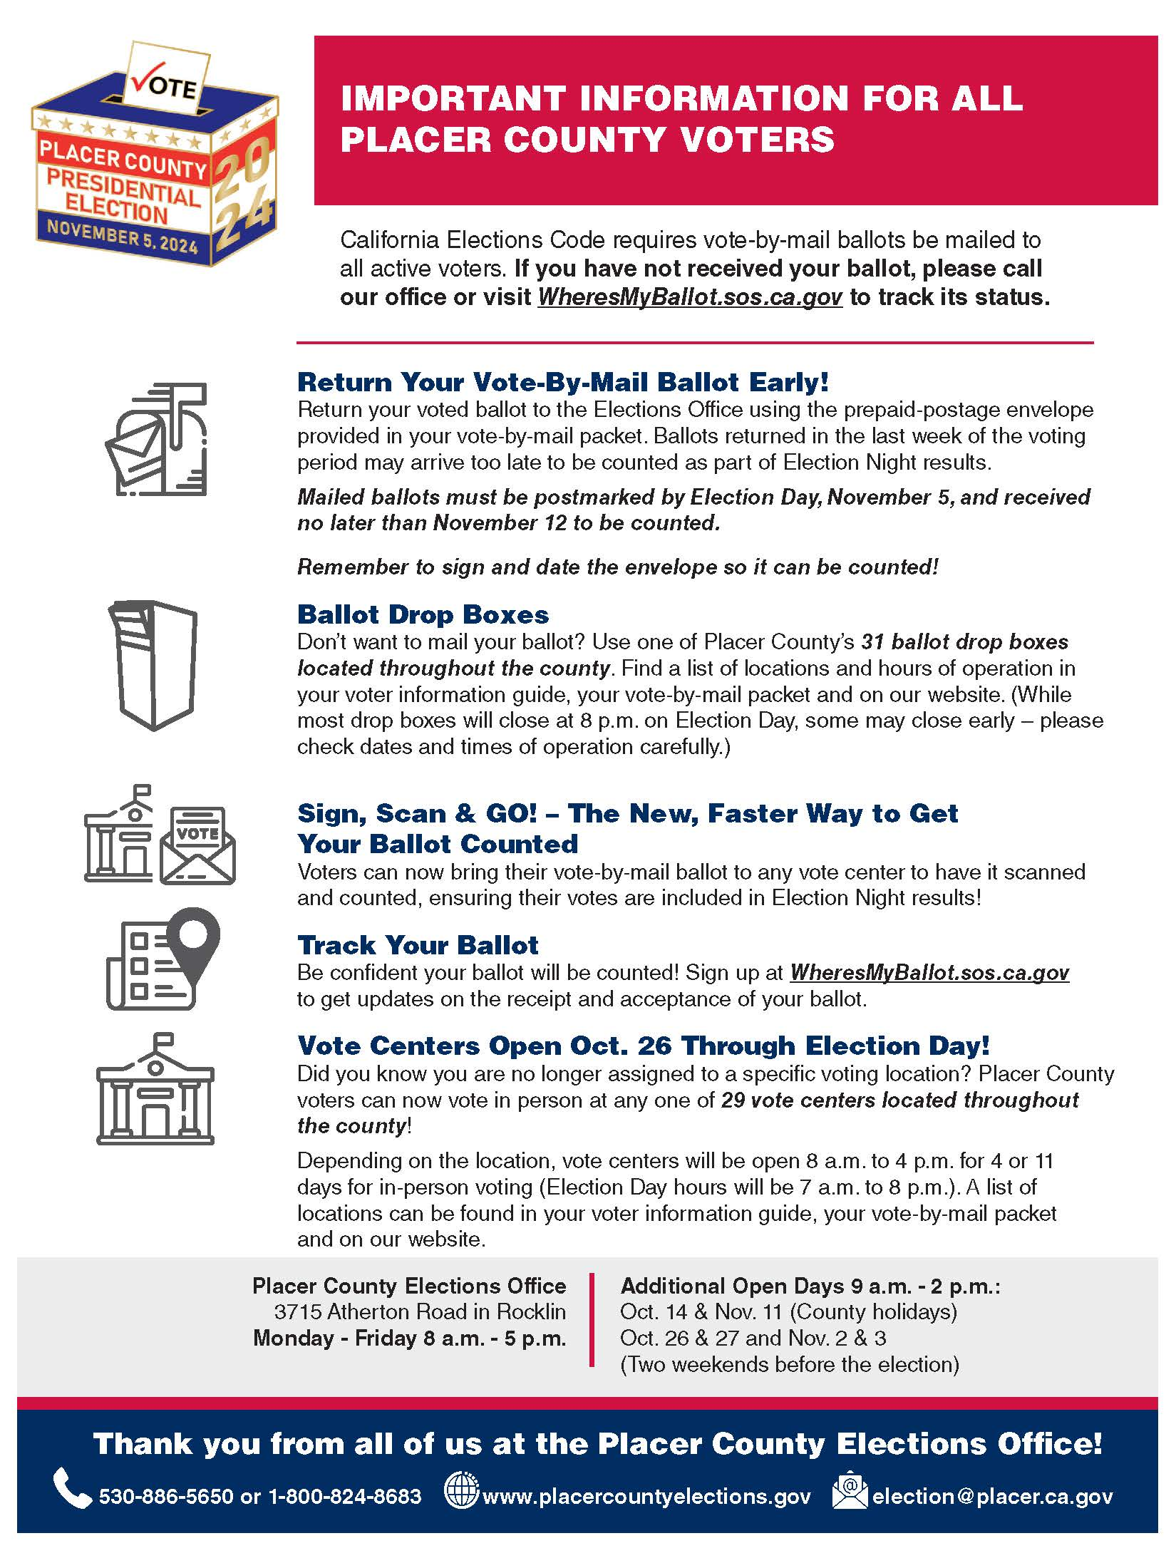
VCA Postcard #2

Slide 20
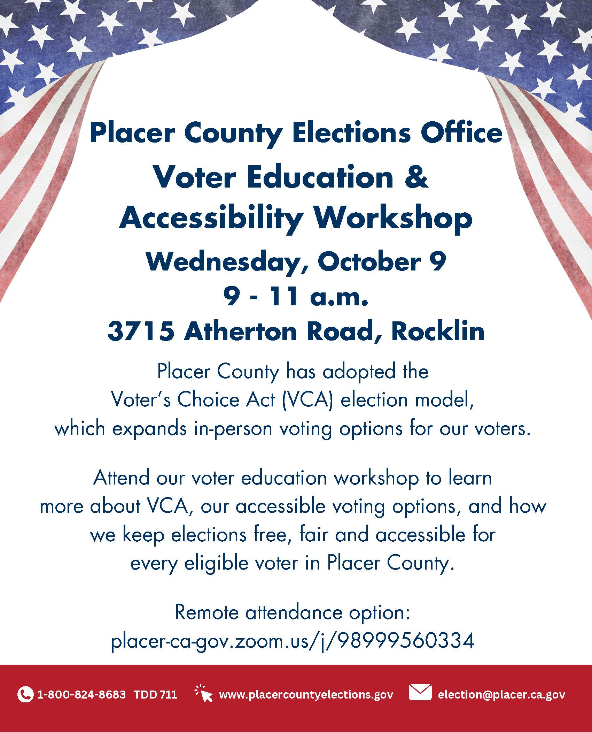
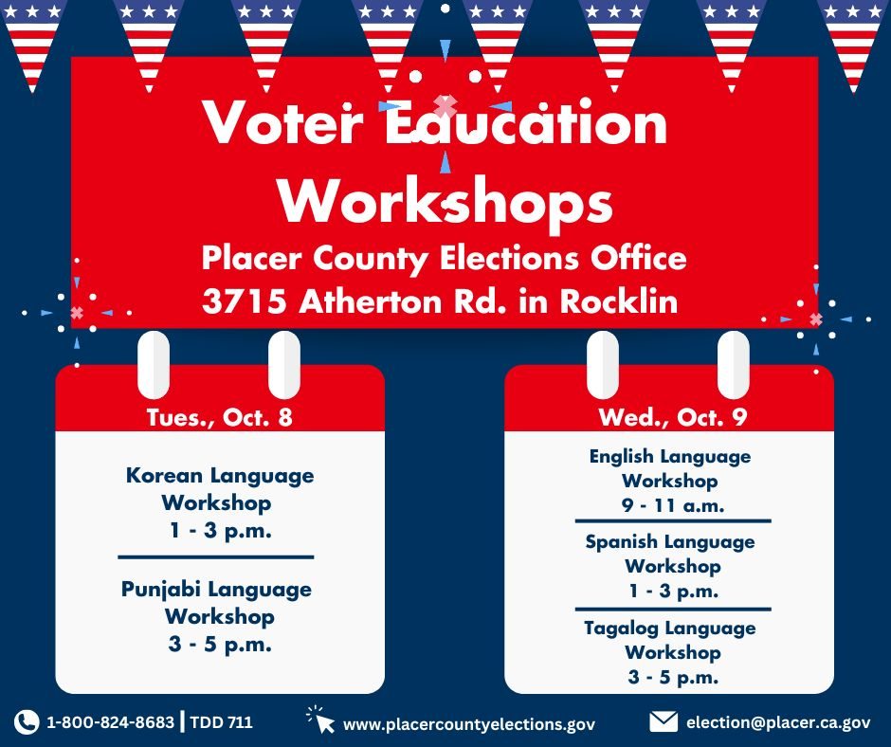
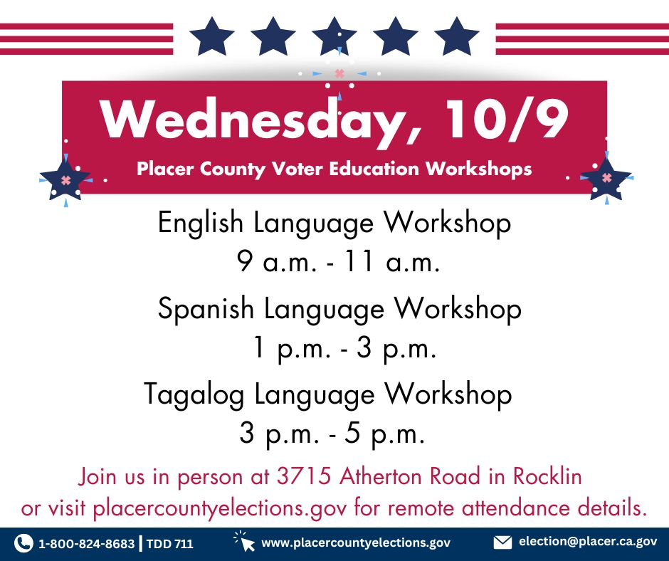
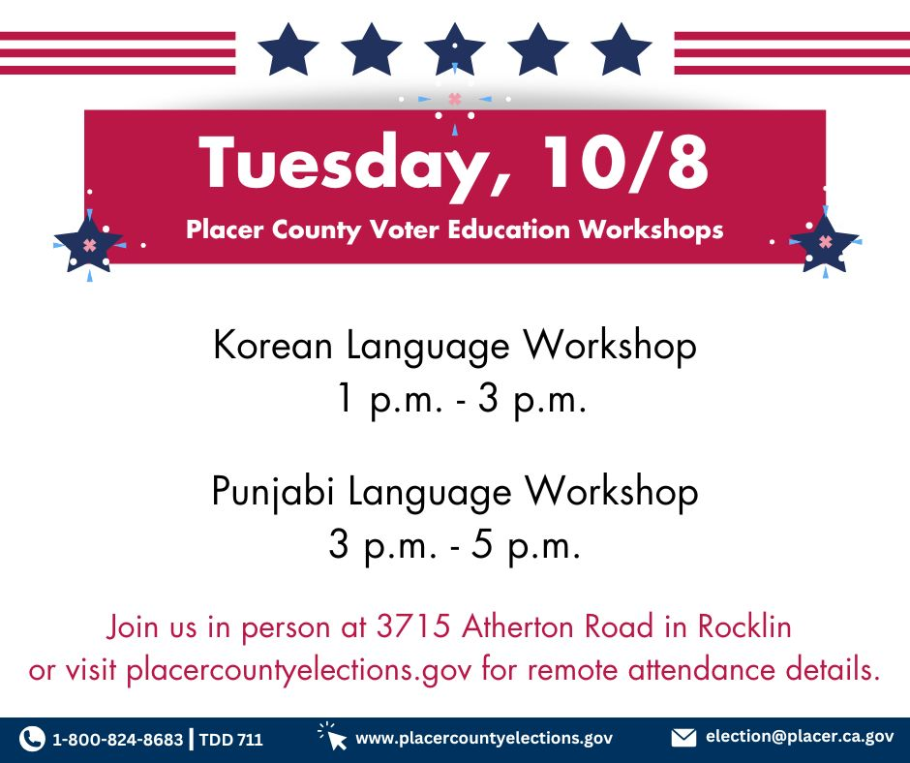
Public Workshops

Slide 21
June 2, 2026 Gubernatorial Primary Election
Only 544 days until the
Notes:
There are only 553 days until the November General Election…

Slide 22
QUESTIONS AND ANSWERS

Slide 23
FUTURE AGENDA ITEMS
FUTURE MEETINGS / SCHEDULE
Notes:
Next Meeting (Tentative): Thursday, September 5, 2024

Slide 24
THANK YOU

